Slide 1
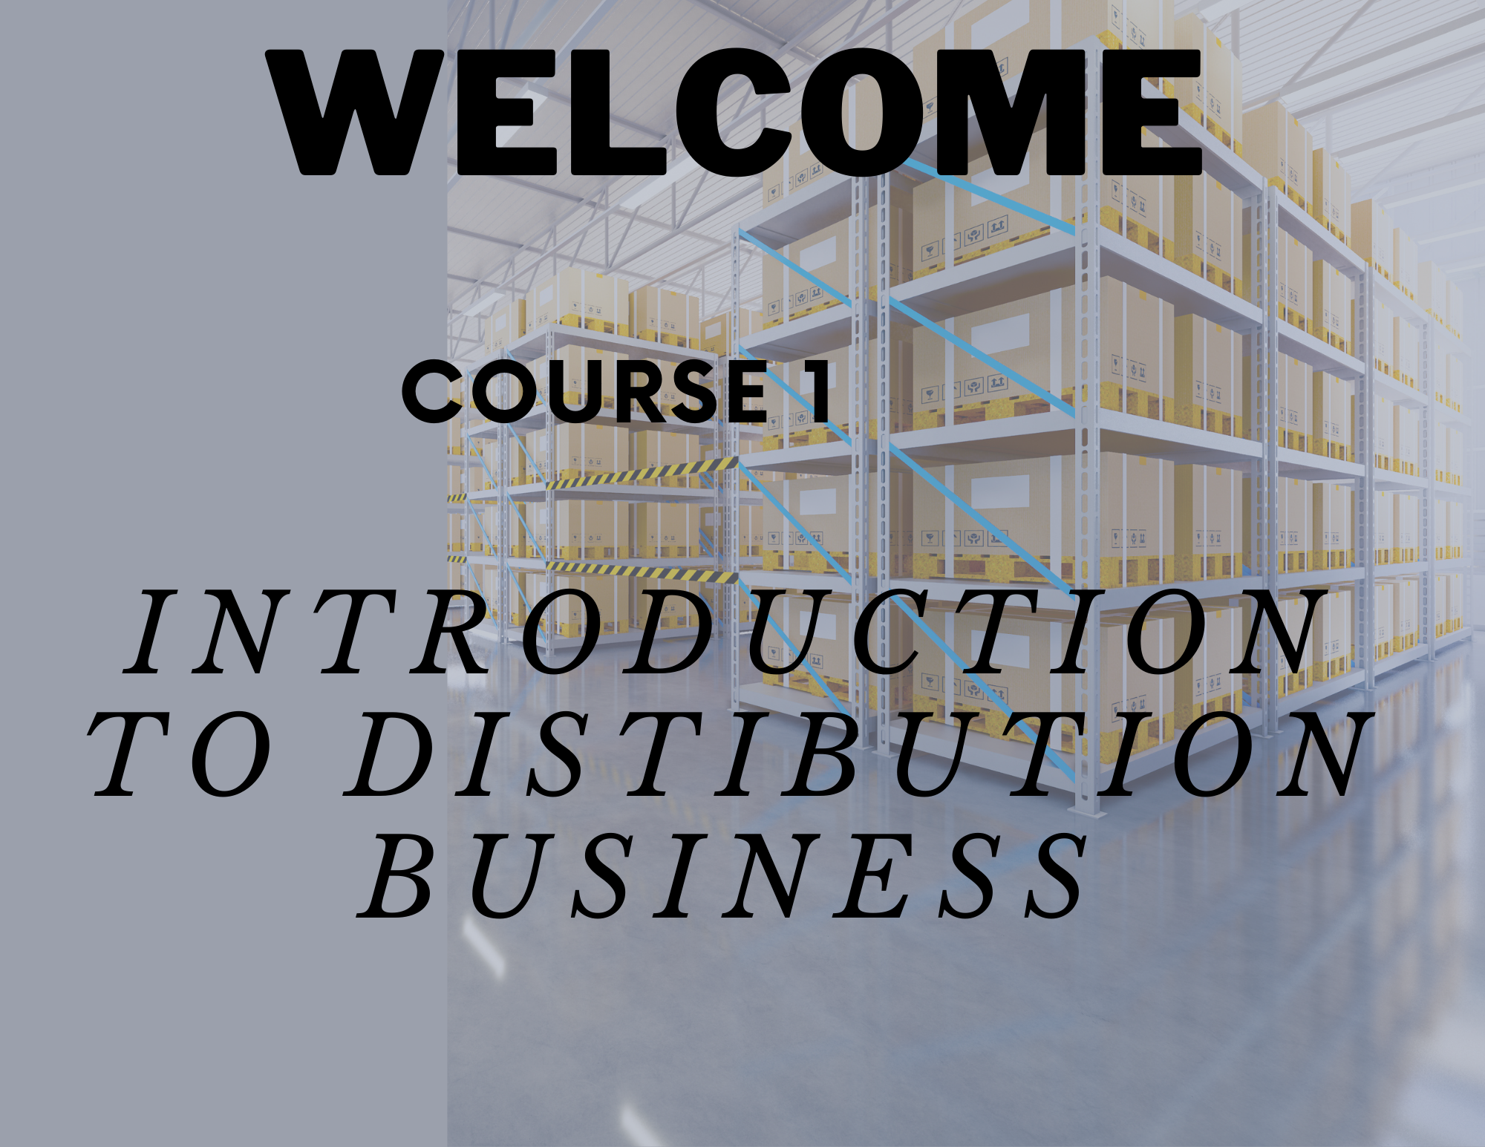
This course helps you understand the opportunities that exist in the distribution business and the profitability of the business. The course is designed to help new entrepreneurs understand the nuances of distribution and things to look for while starting looking for a distribution business.
With this course, I try to bring in all the knowledge and experience working with over 500 Distributors to give practical insights as to what goes into making a profitable distribution business.
The course also gives practical insights to enable you to choose a category or channel which suits you based on your investment potential and risk-taking capacity. I in my long career have witnessed some distributors start from scratch and build a highly profitable business and through this course, I share their best-kept secrets with you.
This course is highly recommended for new entrepreneurs who are looking to start a new business.

Slide 2
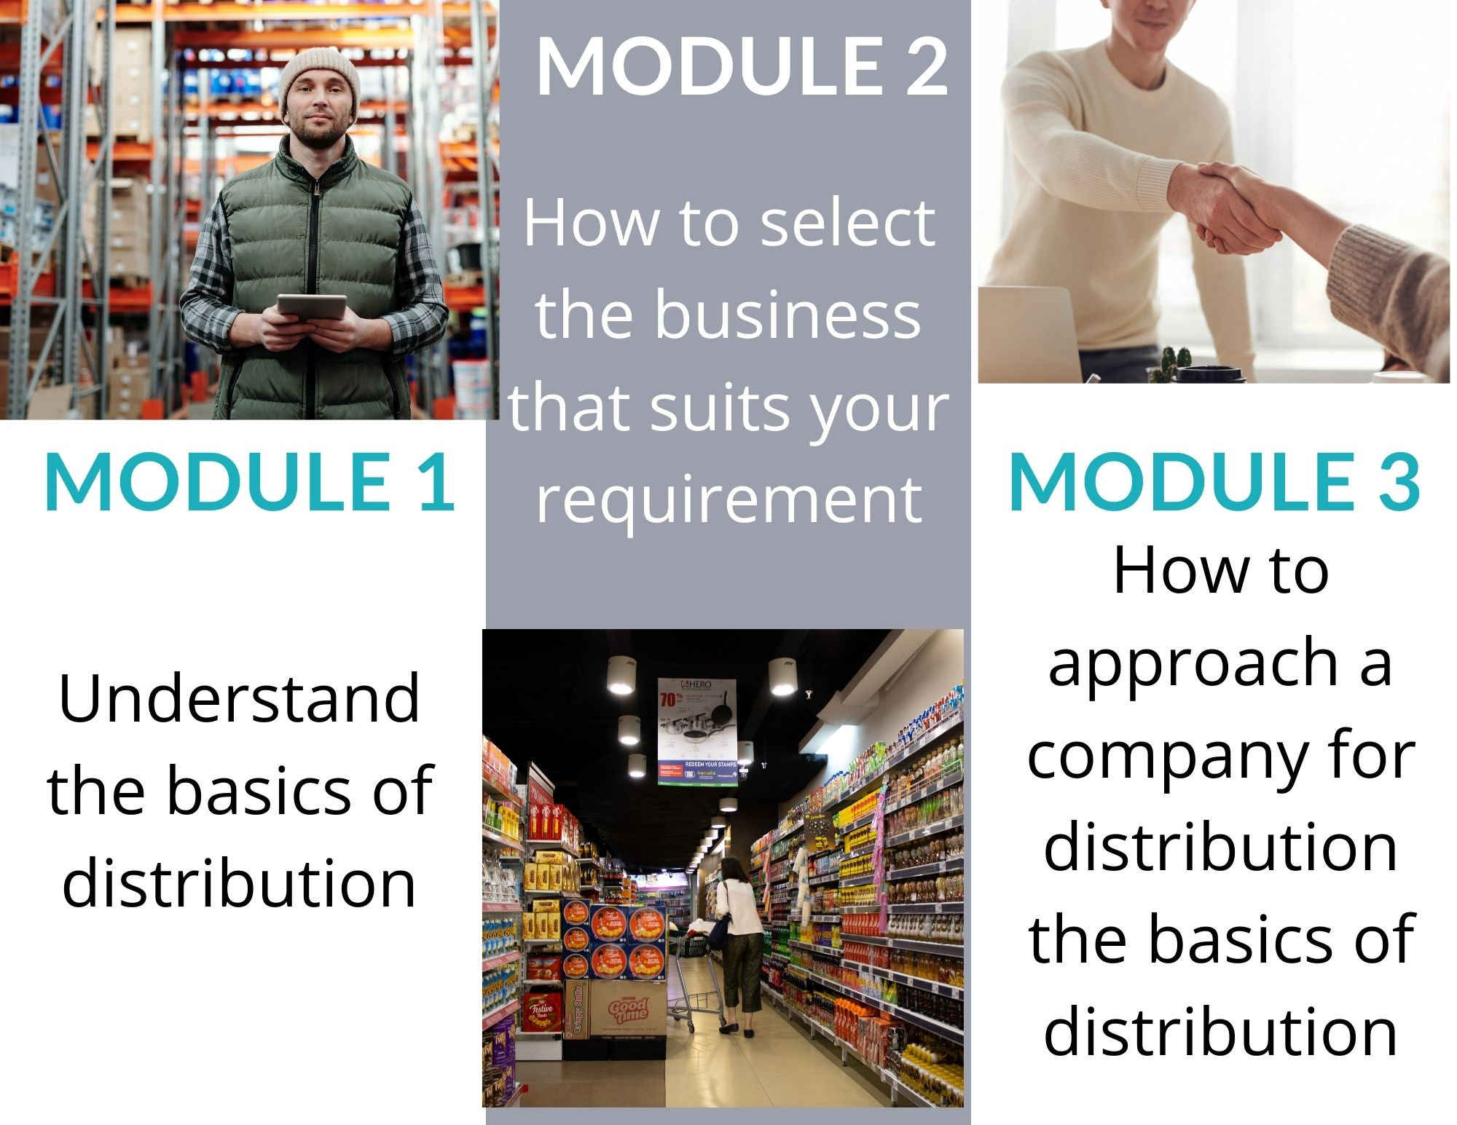

Course content
Introduction to Distribution Business
Welcome
Introduction to the Course
Module 1
Understanding the basics of distribution
Module 2
How to select the business that suits your requirement
Module 3
How to approach a company for distribution

